Slide 1
Filipizen Transactions

Slide 2
Filipizen Transactions
Online Business Registration
Used to register a new business entity
Online Business Renewal
Used to renew an existing business entity
Online Business Billing
Used to generate a billing statement
Online Payment
Used to pay online through Payment Gateway Providers

Slide 3


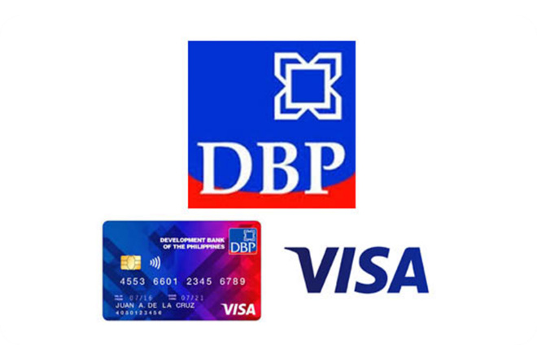
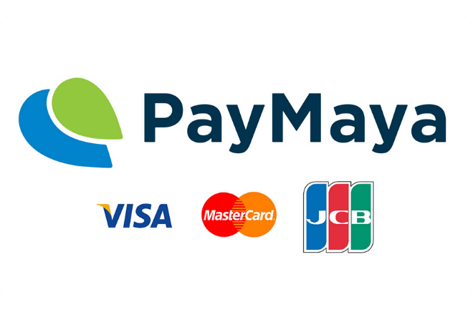
Payment Gateway Providers

Slide 4
Online Business Registration

Slide 5
Process
The applicant will go to the filipizen.com website and choose the LGU partner
Select the Online Business Registration menu
Filling up of the required fields and on-screen data requirements
A tracking number is generated for reference
On final review or confirmation of the inputted information, the applicant must click the Submit button so that the application will be submitted to the LGU otherwise it will remain as draft

Slide 6
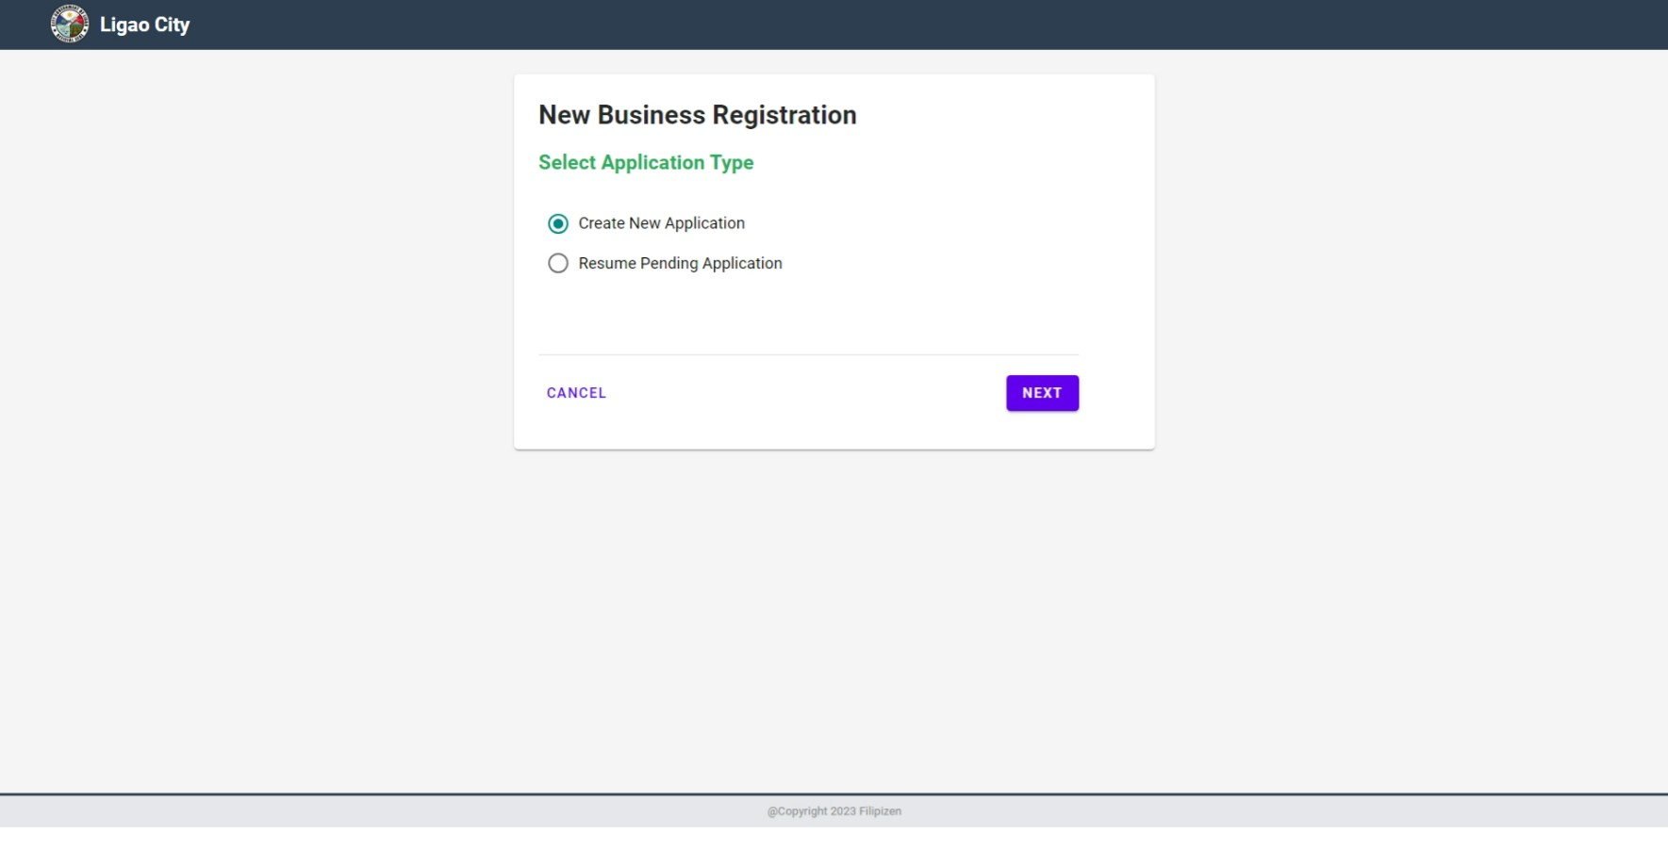
Online Business Registration
Page 1

Slide 7
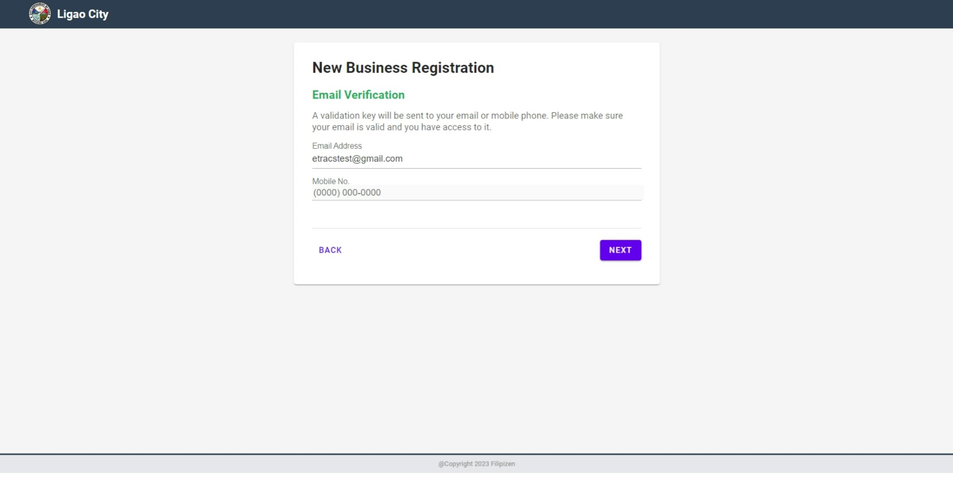
Online Business Registration
Page 2

Slide 8
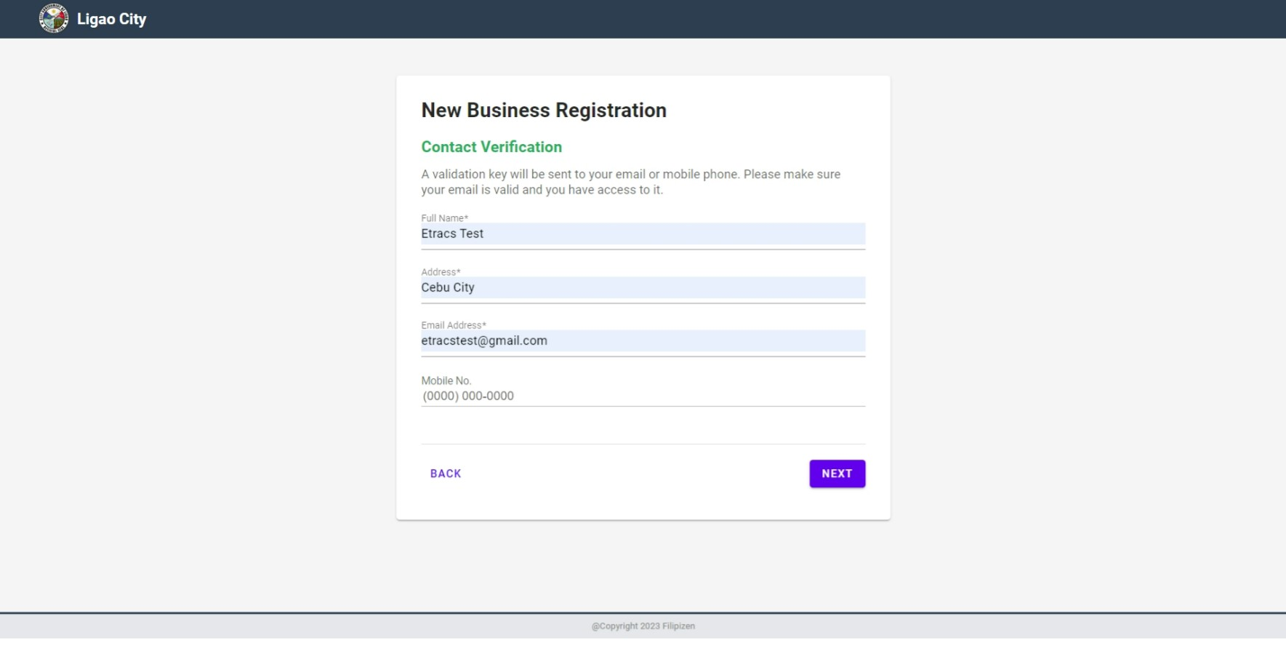
Online Business Registration
Page 3

Slide 9
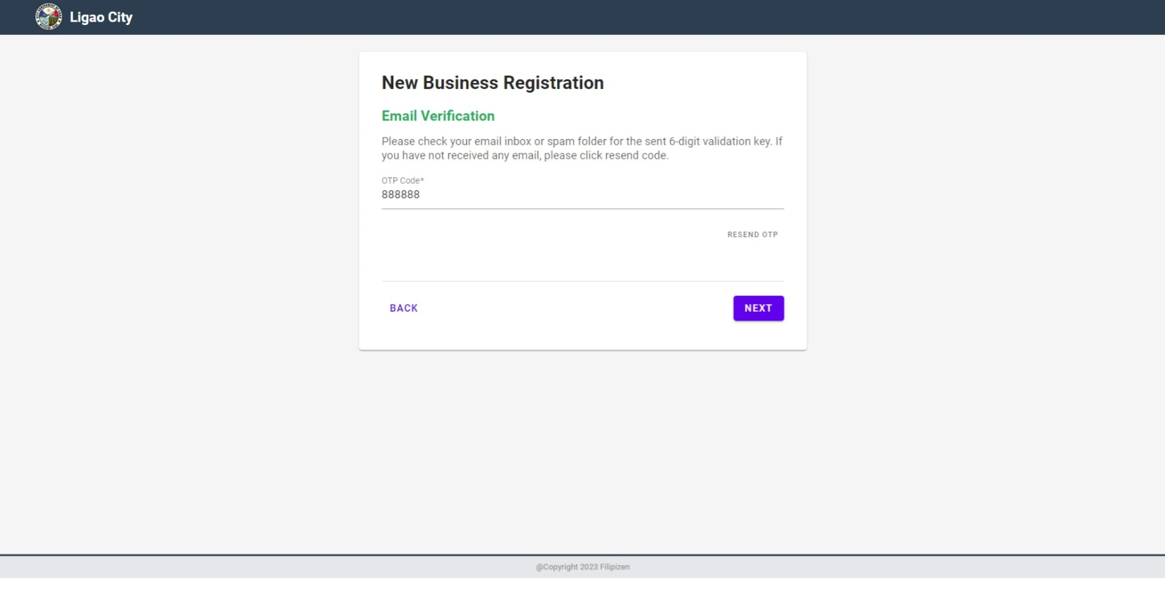
Online Business Registration
Page 4

Slide 10
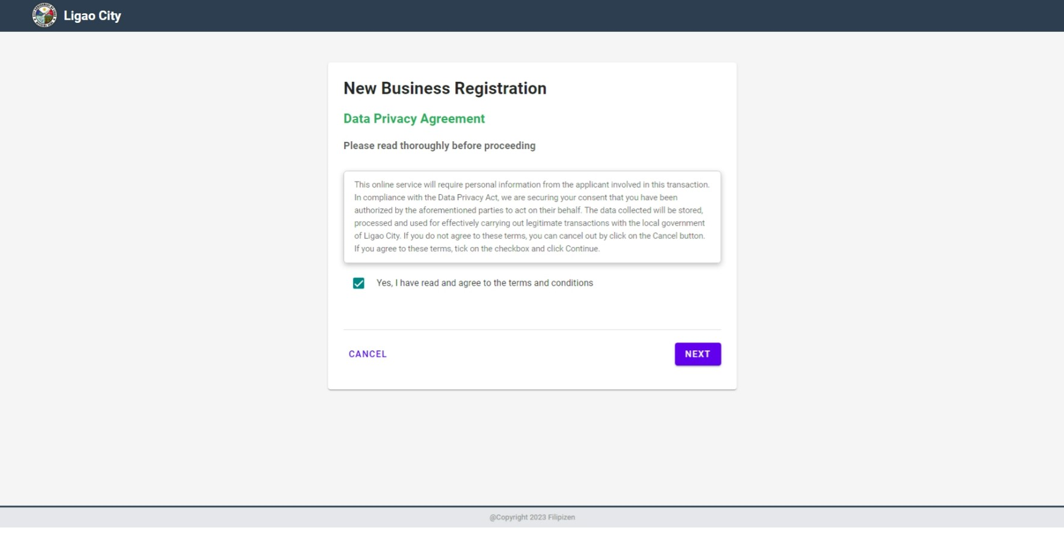
Online Business Registration
Page 5

Slide 11
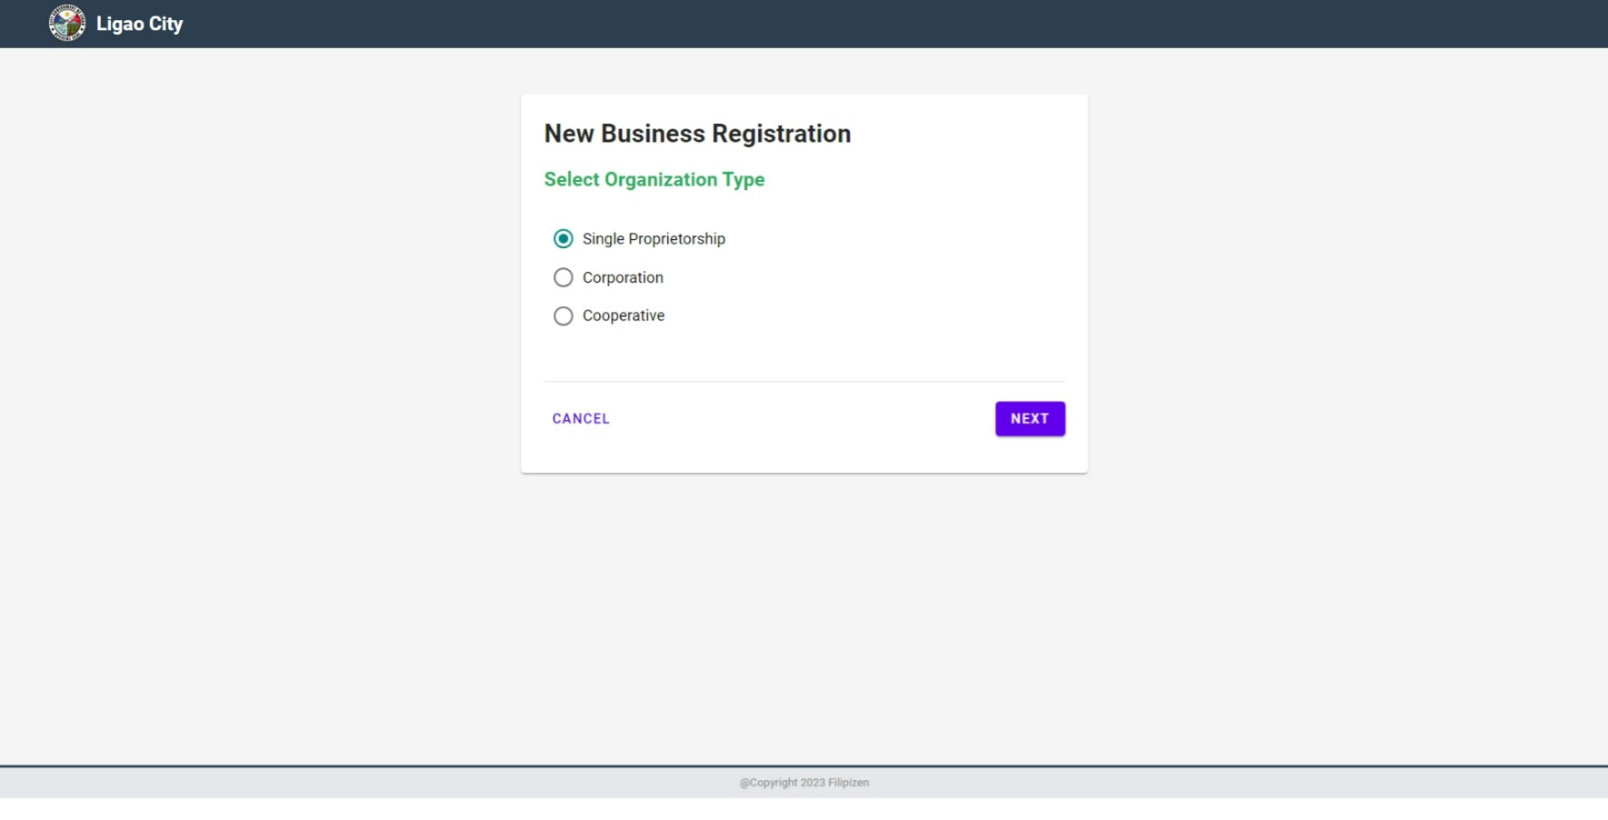
Online Business Registration
Page 6

Slide 12
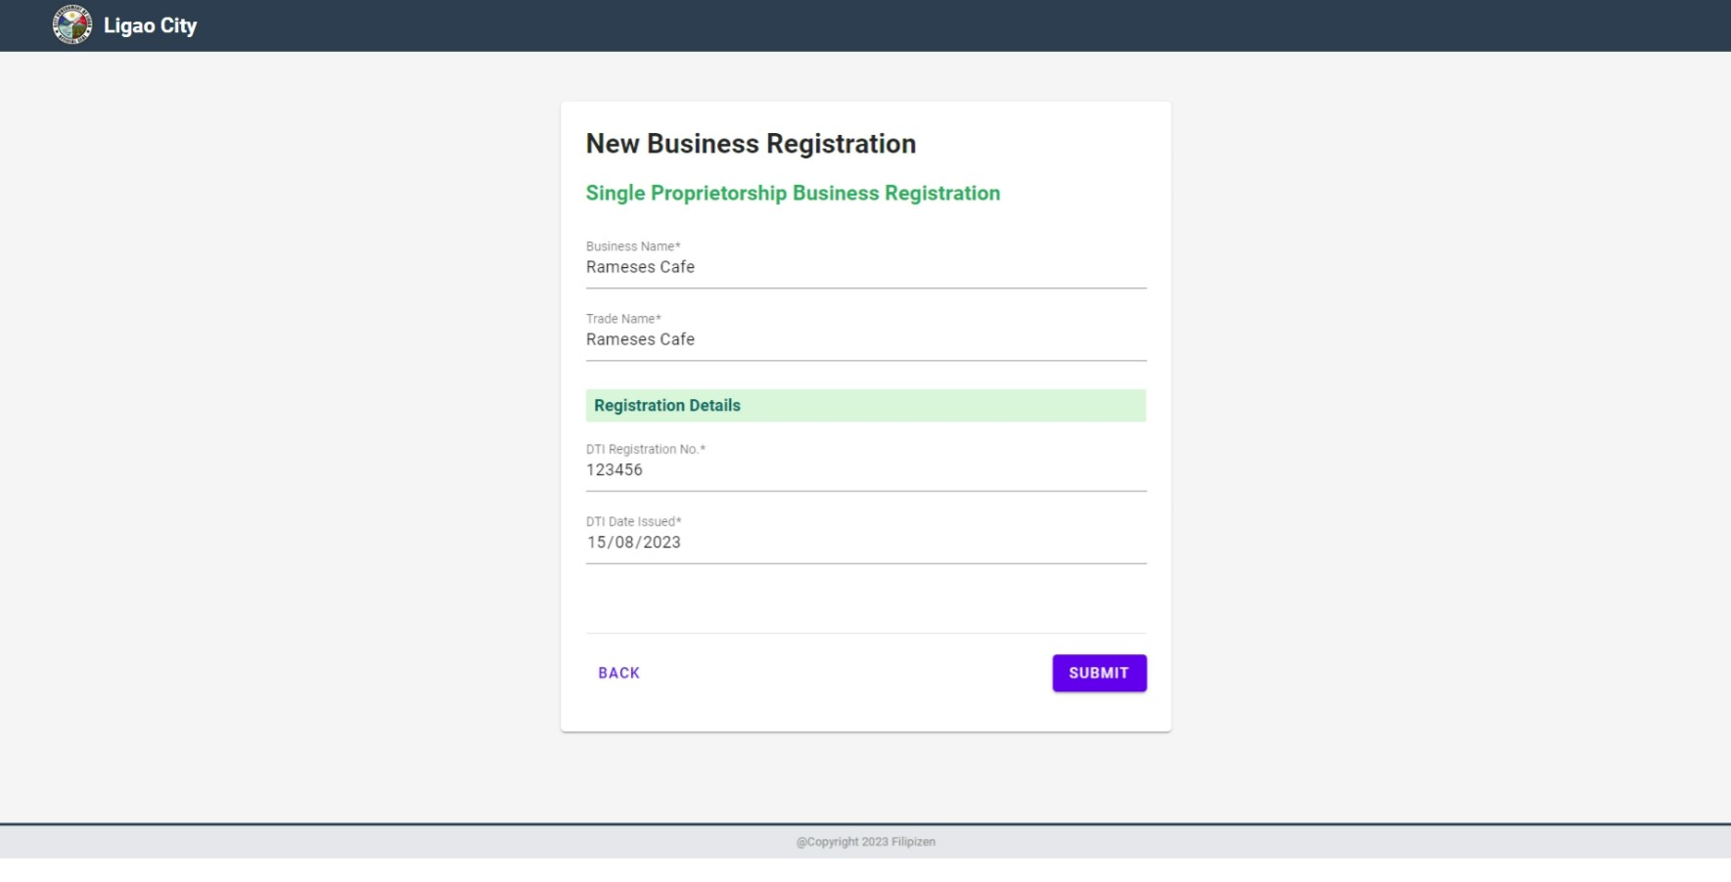
Online Business Registration
Page 7

Slide 13
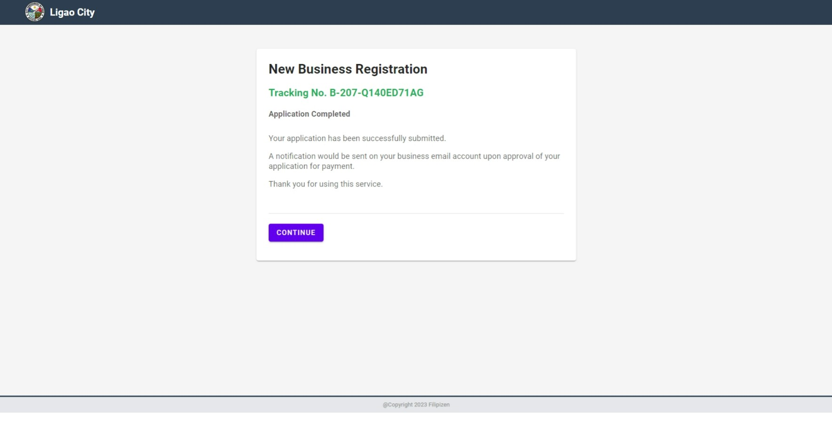
Online Business Registration
Page 8

Slide 14
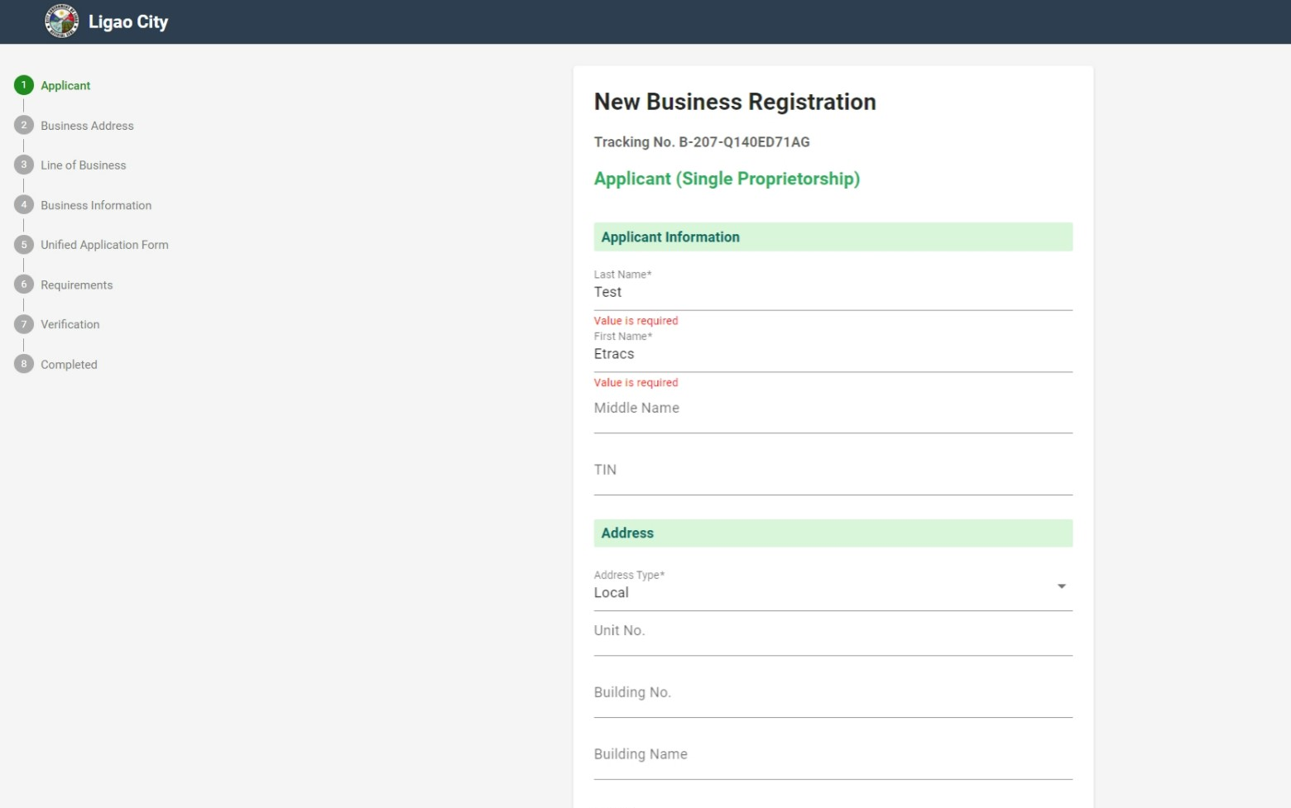
Online Business Registration
Page 9

Slide 15
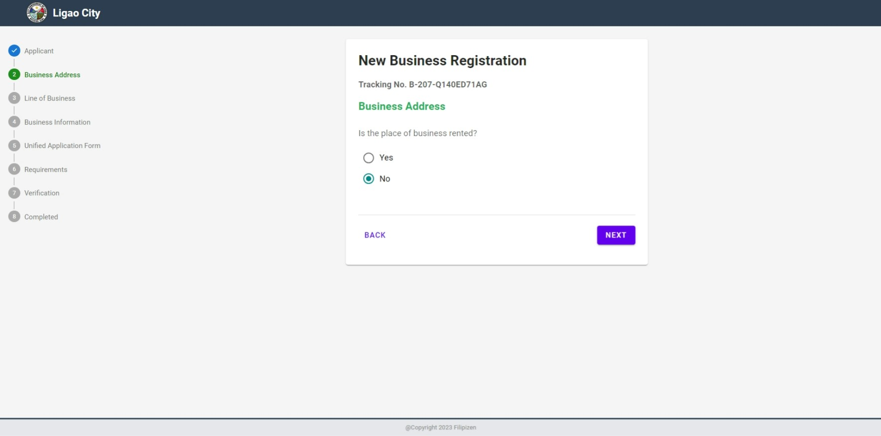
Online Business Registration
Page 10

Slide 16
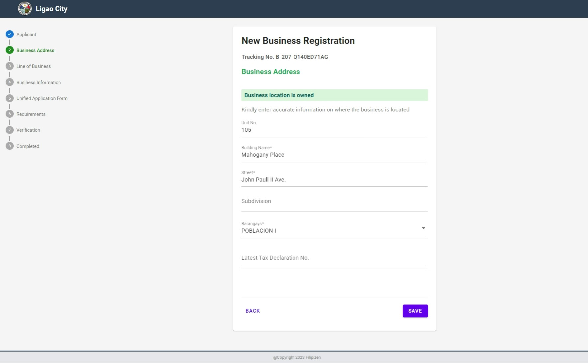
Online Business Registration
Page 11

Slide 17
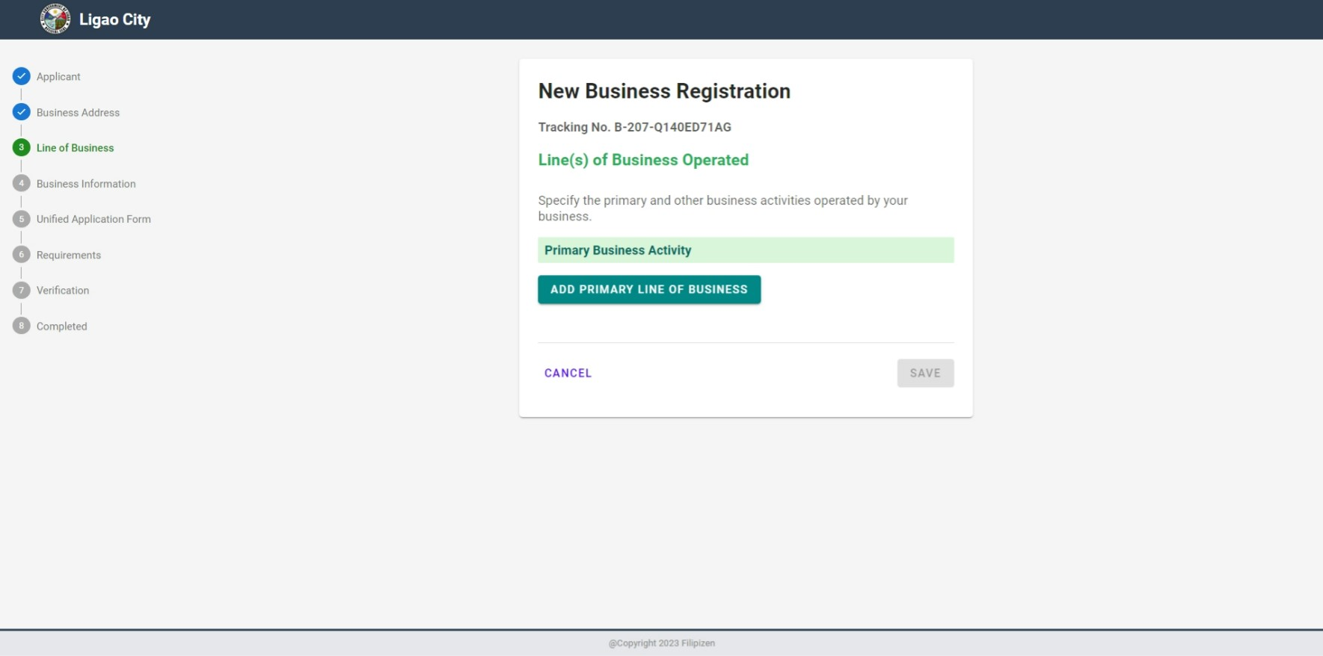
Online Business Registration
Page 12

Slide 18
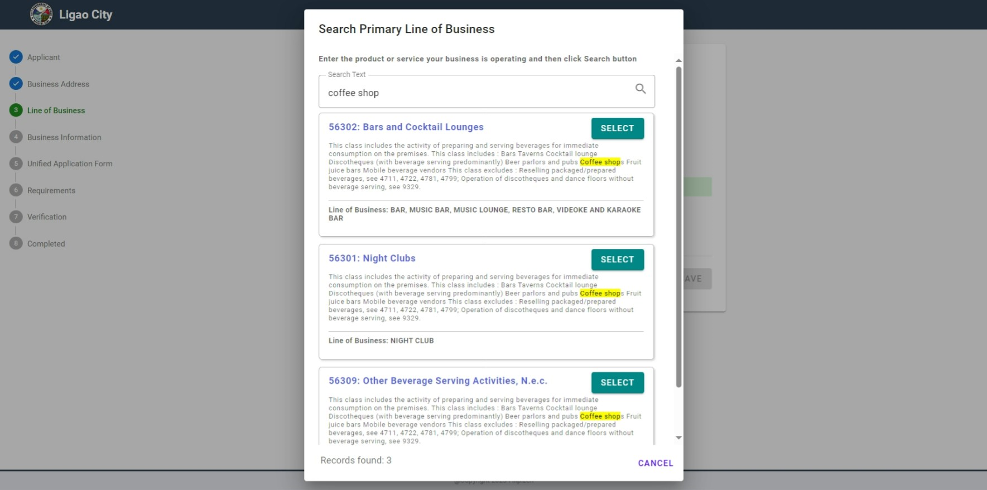
Online Business Registration
Page 13

Slide 19
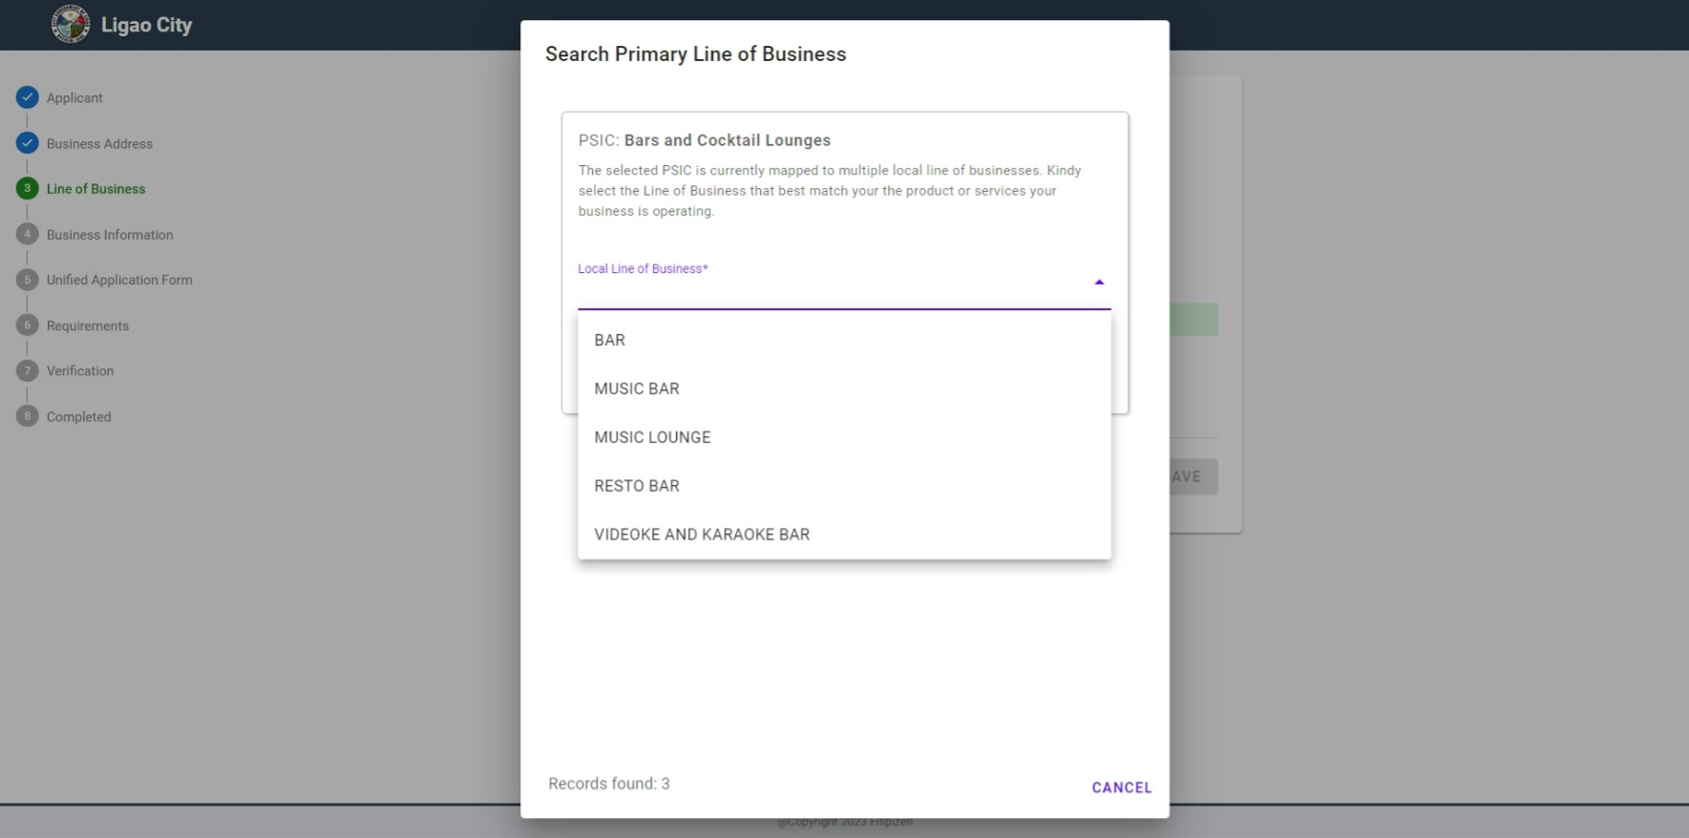
Online Business Registration
Page 14

Slide 20
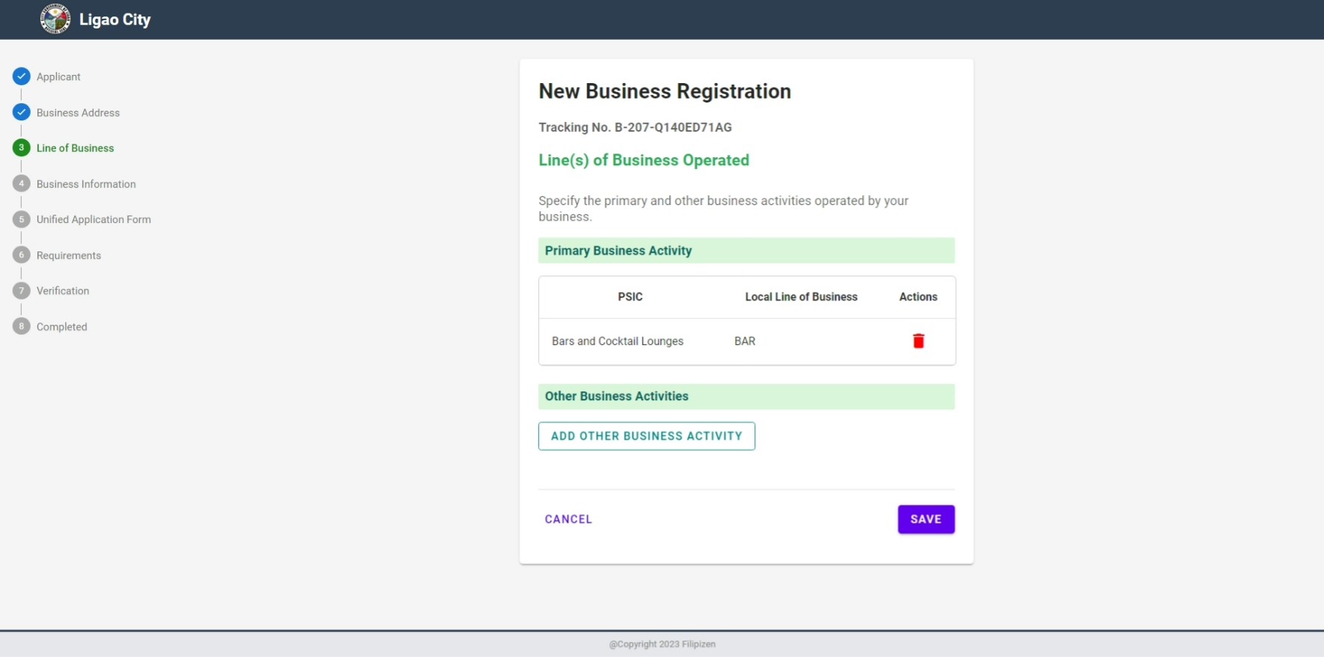
Online Business Registration
Page 15

Slide 21
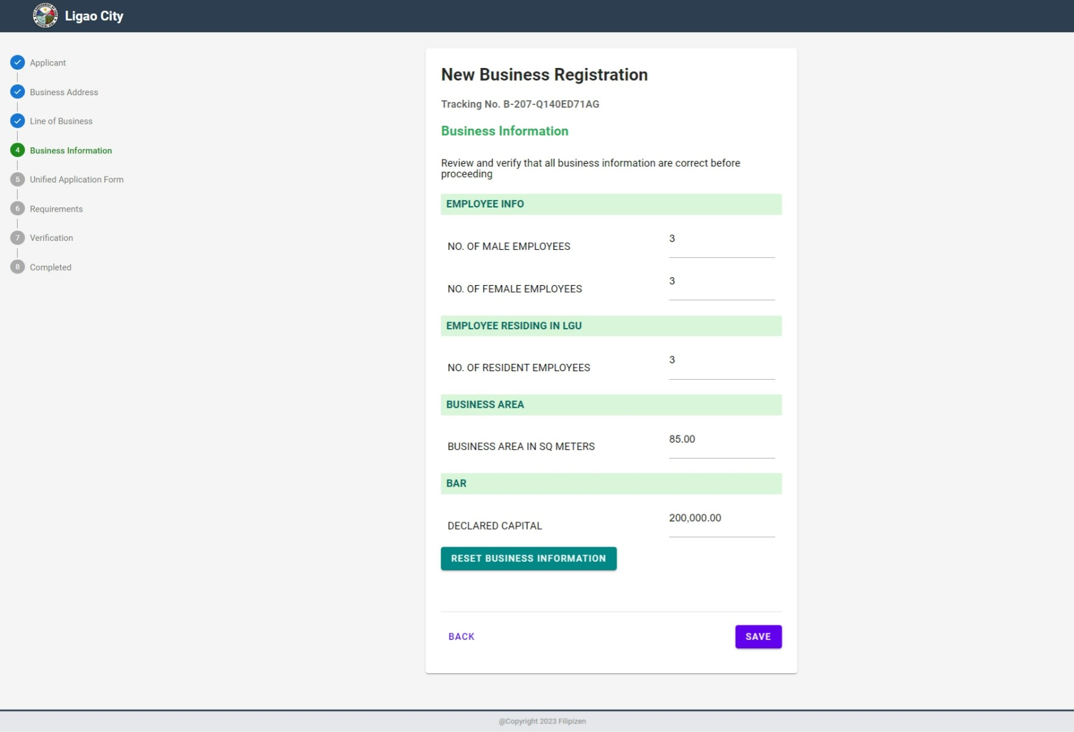
Online Business Registration
Page 16

Slide 22
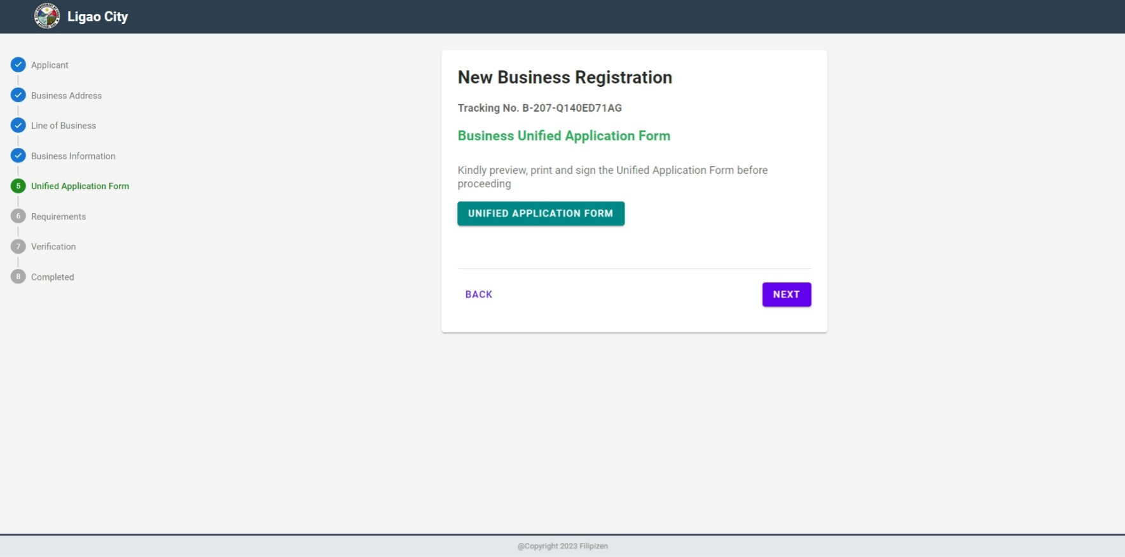
Online Business Registration
Page 17

Slide 23
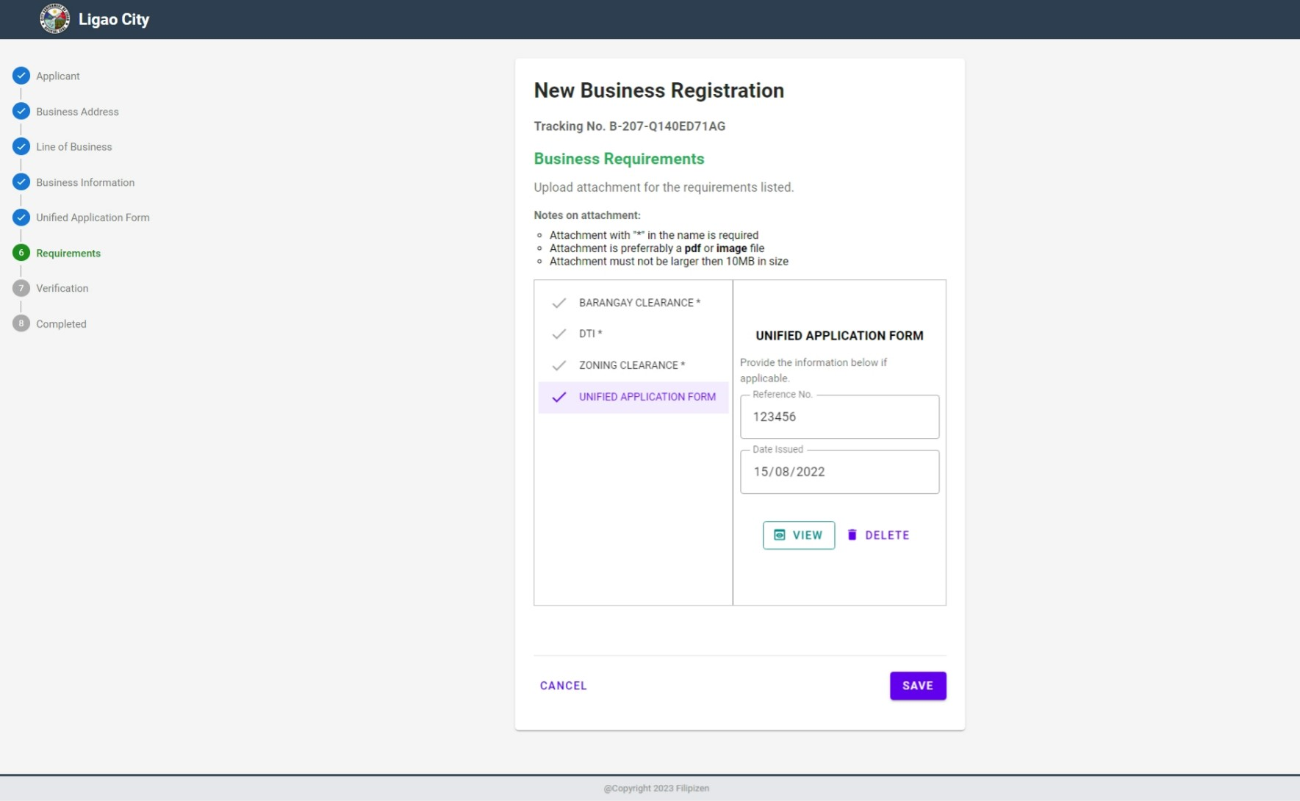
Online Business Registration
Page 18

Slide 24
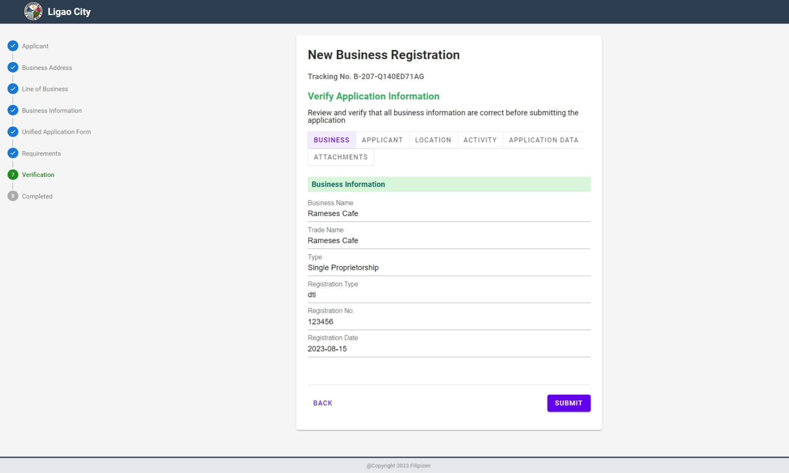
Online Business Registration
Page 19

Slide 25
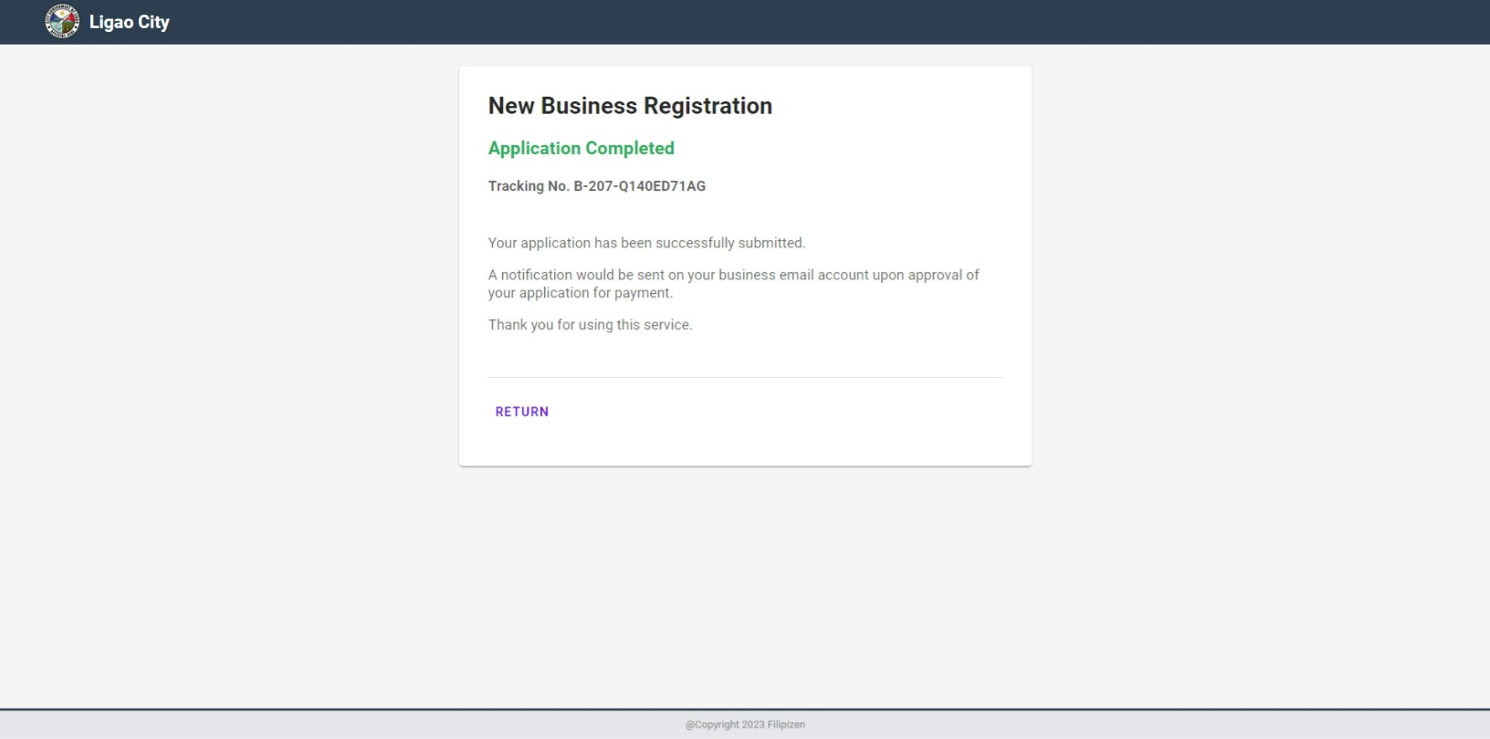
Online Business Registration
Page 20

Slide 26
Process Online Business Registration LGU Level

Slide 27
Process
The user will go to the menu Home-> Business-> Online-> View Online Applications
Select the Open menu item and open a particular record
Click the Map Taxpayer Profile action to create or select an existing profile
Review the information and attachments
Once completed, click the Approve for Processing button and this will create an official business application record with BIN, and will go through the internal workflow process in processing a business application
An email will be sent to the applicant notifying the current status of the application
An email will be sent again as soon as the application is approved for payment
After payment made, releasing and issuance permit is performed

Slide 28
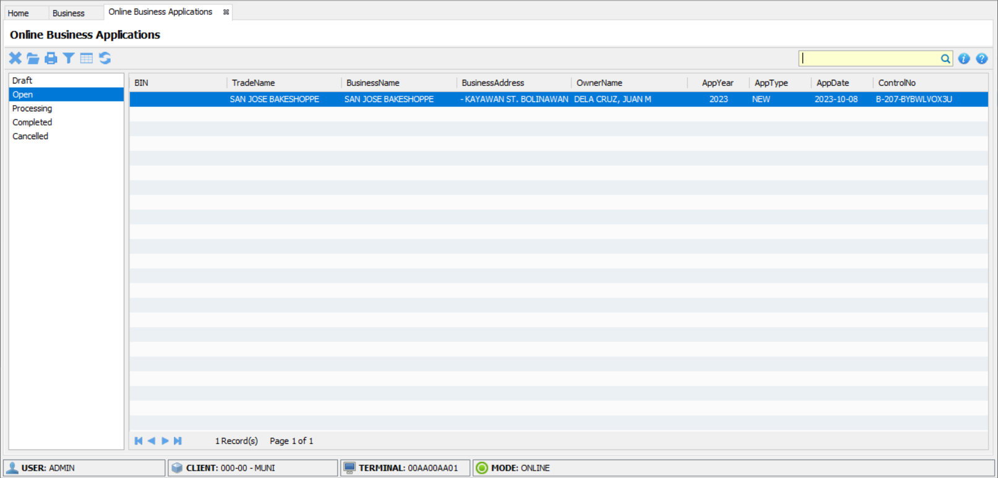
Processing Online Business Registration
Page 1

Slide 29
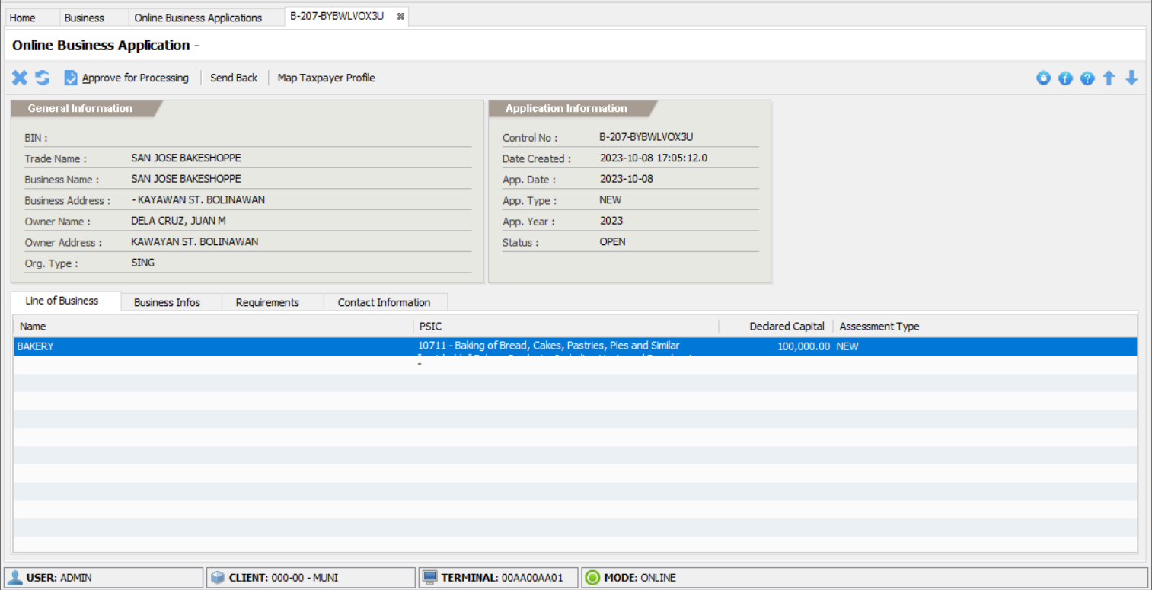
Processing Online Business Registration
Page 2

Slide 30
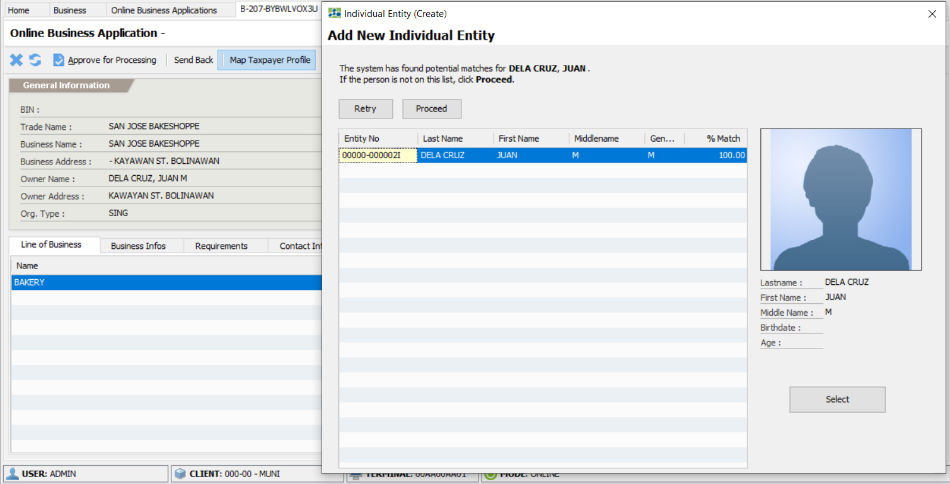
Processing Online Business Registration
Page 3

Slide 31
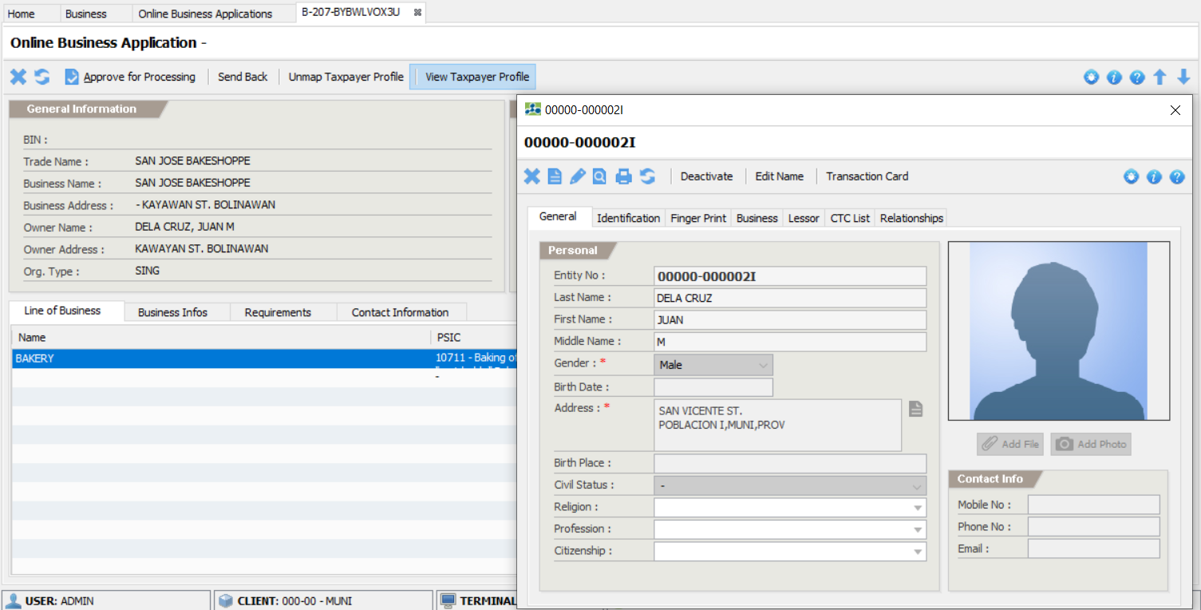
Processing Online Business Registration
Page 4

Slide 32
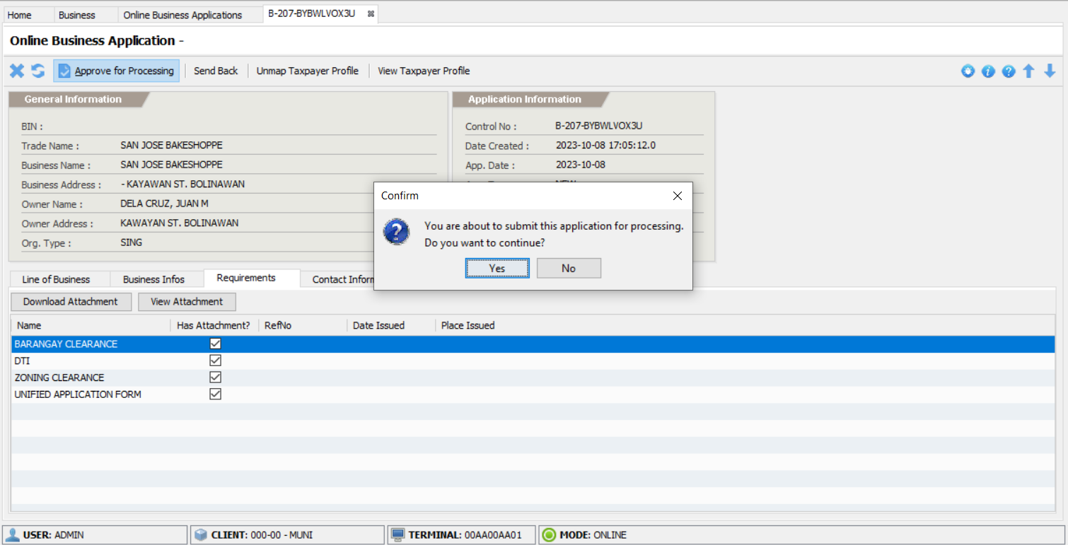
Processing Online Business Registration
Page 5

Slide 33
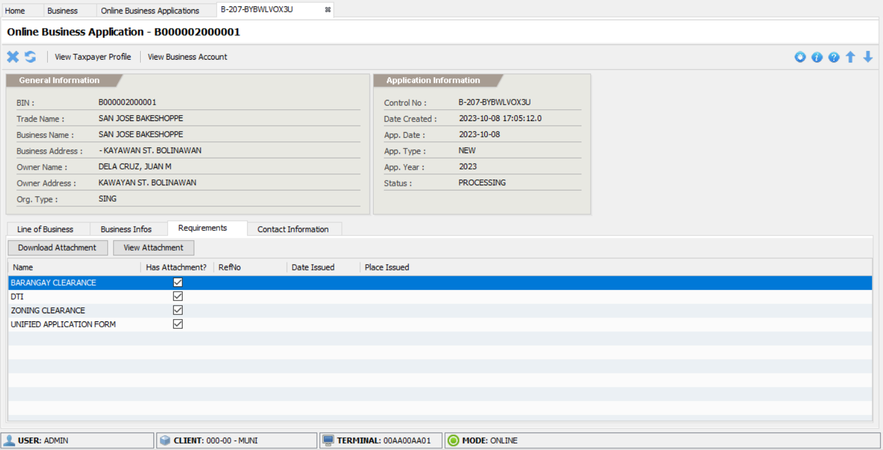
Processing Online Business Registration
Page 6

Slide 34
OBO Assess The Application
Open the application from the notification menu or go to Home-> Business-> Management-> View Applications and click the Engineering folder
Click the Assign To Me button
Click the Recurring Fees menu item
Click the Add Fee button
After completely added the fees, click the Submit button

Slide 35
MHO Assess The Application
Open the application from the notification menu or go to Home-> Business-> Management-> View Applications and click the MHO folder
Click the Assign To Me button
Click the MHO Fees menu item
Click the Add Fee button
After completely added the fees, click the Submit button

Slide 36
MPDO Assess The Application
Open the application from the notification menu or go to Home-> Business-> Management-> View Applications and click the MPDO folder
Click the Assign To Me button
Click the MPDO Fees menu item
Click the Add Fee button
After completely added the fees, click the Submit button

Slide 37
Assessor Assess The Application
Open the application from the notification menu or go to Home-> Business-> Management-> View Applications and click the Assign Assessor folder
Click the Assign To Me button
Click the Assessment menu item
Click the Assess button and provide the necessary information to output the correct computation of fees
After completely assessed, click the Submit for Approval button

Slide 38
Approver Approves The Application
Open the application from the notification menu or go to Home-> Business-> Management-> View Applications and click the Approval folder
Click the Assign To Me button
Click the Assessment menu item to review the fees
Click the Approve For Payment button to marked the application as ‘for-payment’ and then an email sent to the applicant notifying that the application is ready for payment

Slide 39
BFP Process the Application
Open the application from the notification menu or go to Home-> Business-> Management-> View Applications and click the BFP folder
Click the Assign To Me button
Compute the fees for payment
Once completed, click the Submit button

Slide 40
Process the Payment
The payment can now be done online or over-the-counter.
As soon as the payment has been made, the application will move to the next step.

Slide 41
Licensing Process the Application
Open the application from the notification menu or go to Home-> Business-> Management-> View Applications and click the For Release folder
Review the requirements
After the review, click the Release button
Click the Issue Permit button
Print the permit or send the permit as PDF via email

Slide 42
Online Business Renewal

Slide 43
Process
The applicant will go to the filipizen.com website and choose the LGU partner
Select the Renew Business Application menu
Filling up of the required fields and on-screen data requirements
A tracking number is generated for reference
On final review or confirmation of the inputted information, the applicant must click the Submit button so that the application will be submitted to the LGU otherwise it will remain as draft

Slide 44
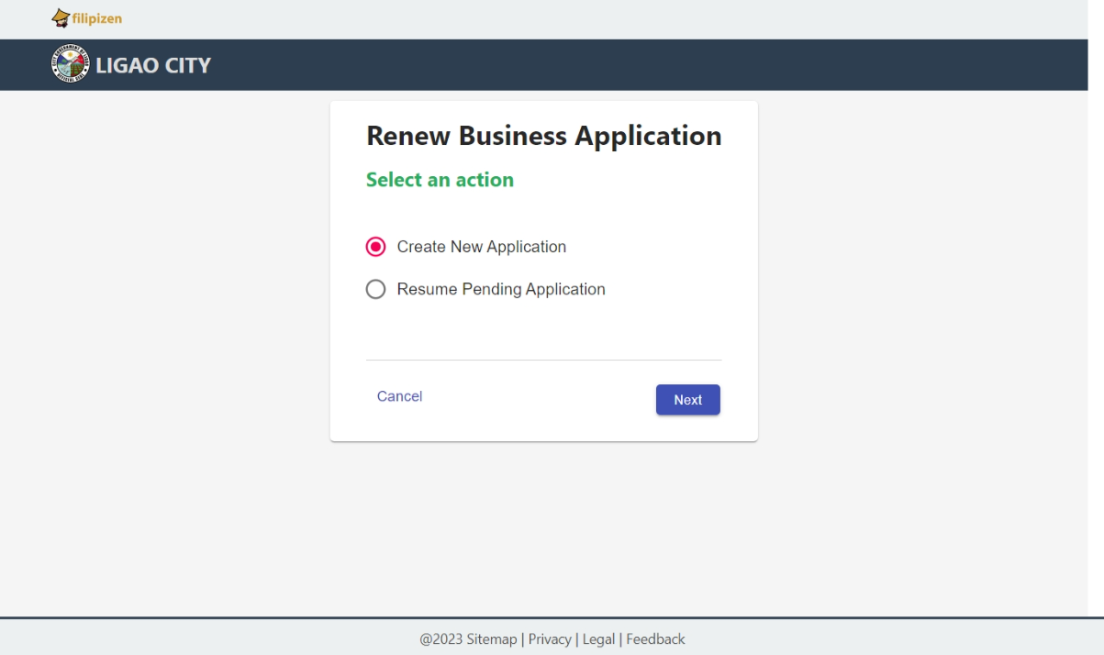
Online Business Renewal
Page 1

Slide 45
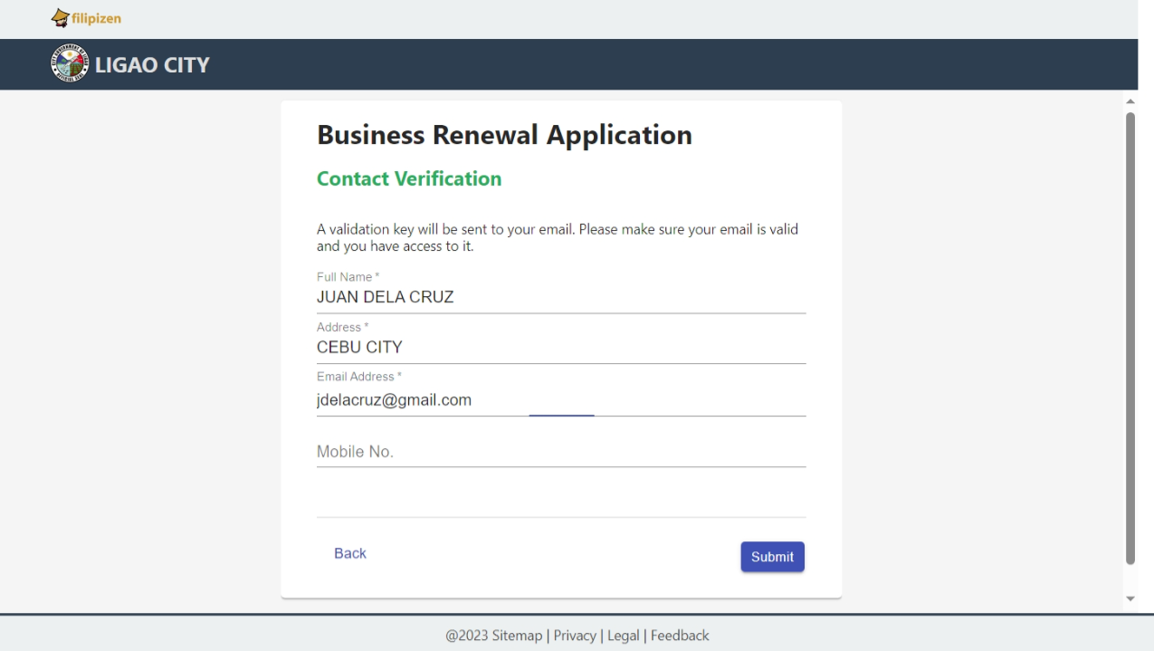
Online Business Renewal
Page 2

Slide 46
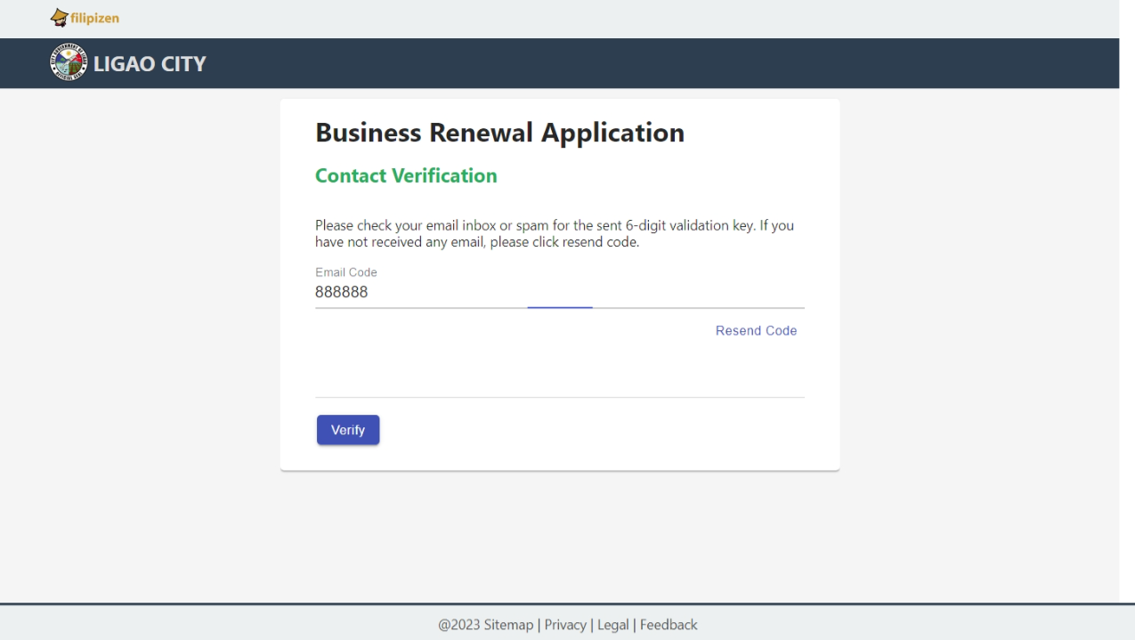
Online Business Renewal
Page 3

Slide 47
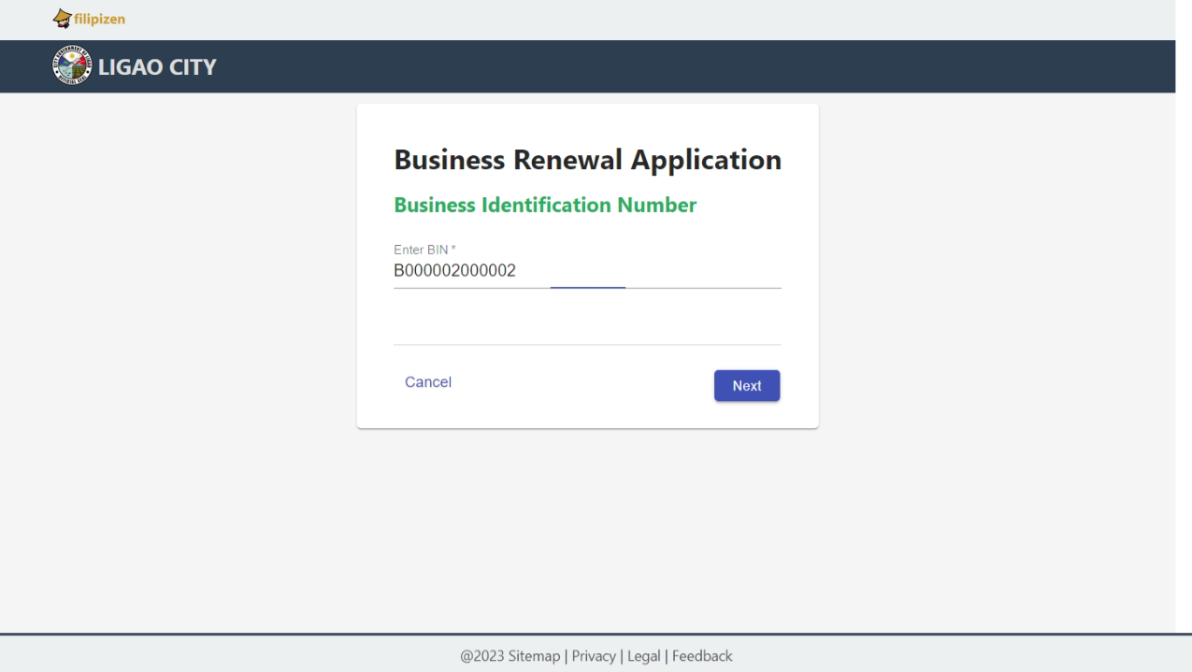
Online Business Renewal
Page 4

Slide 48
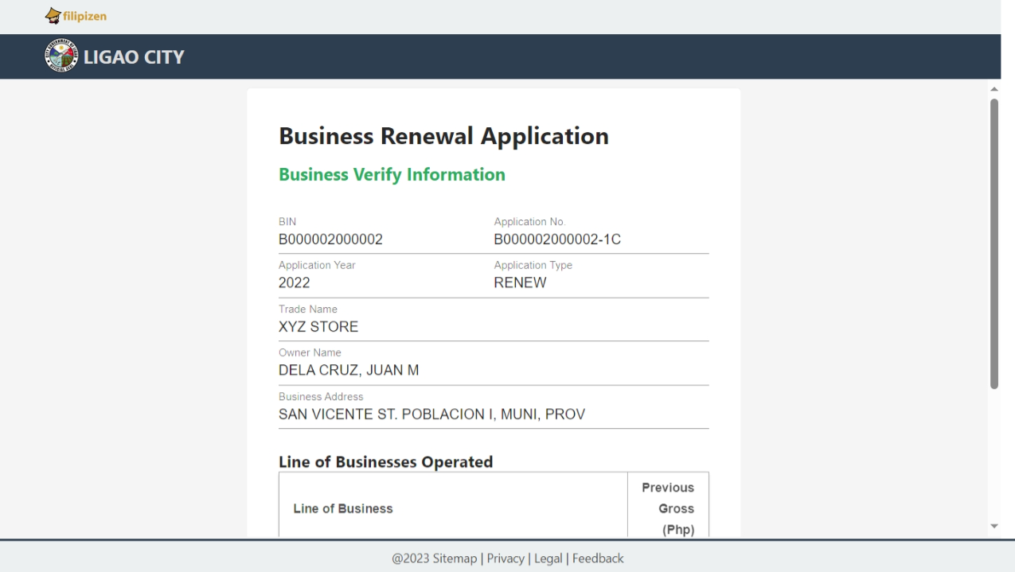
Online Business Renewal
Page 5

Slide 49
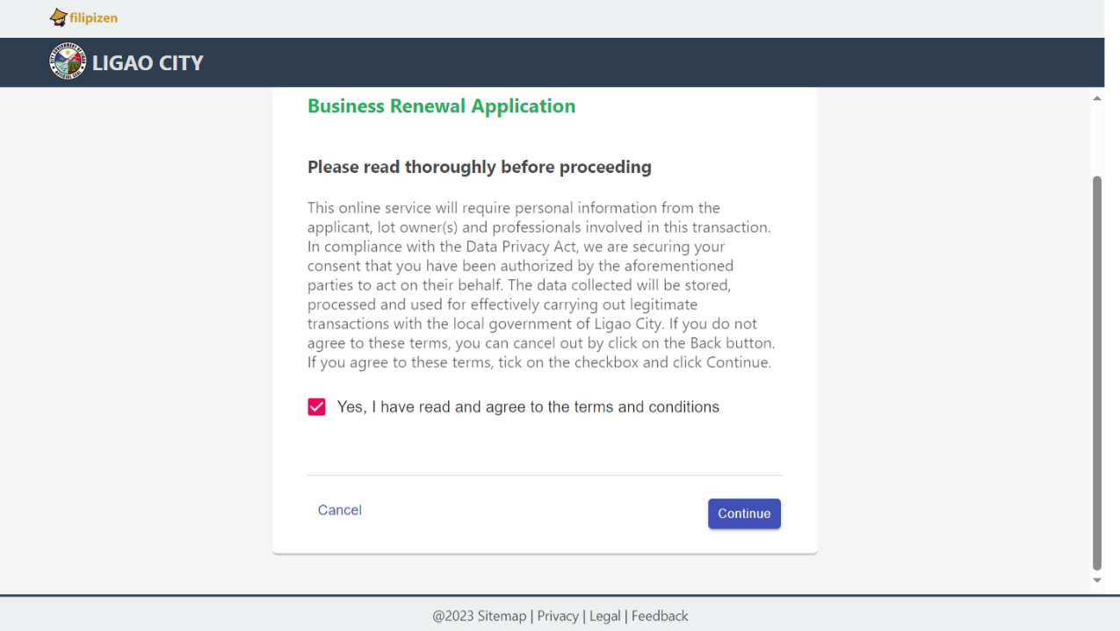
Online Business Renewal
Page 6

Slide 50
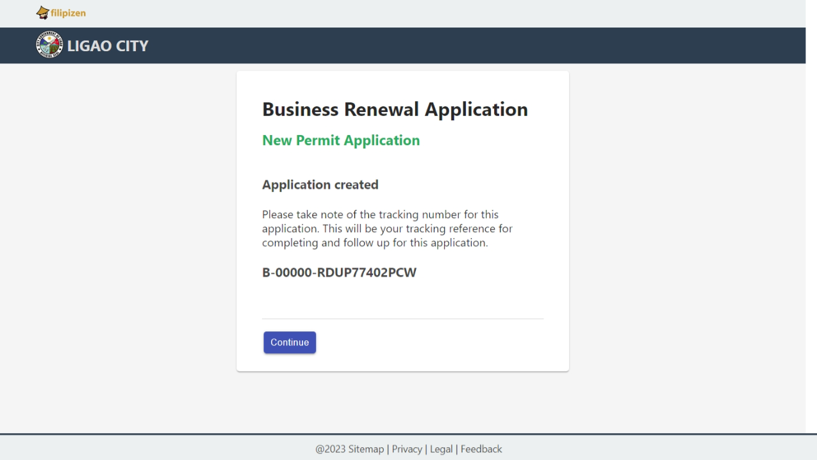
Online Business Renewal
Page 7

Slide 51
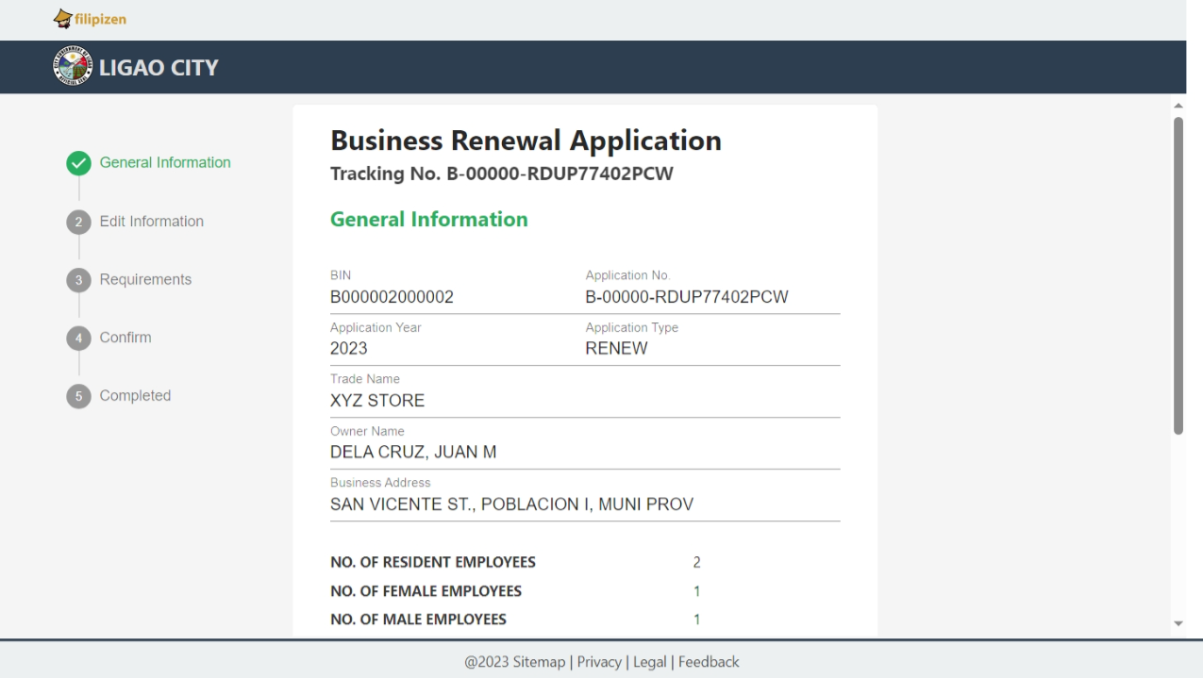
Online Business Renewal
Page 8

Slide 52
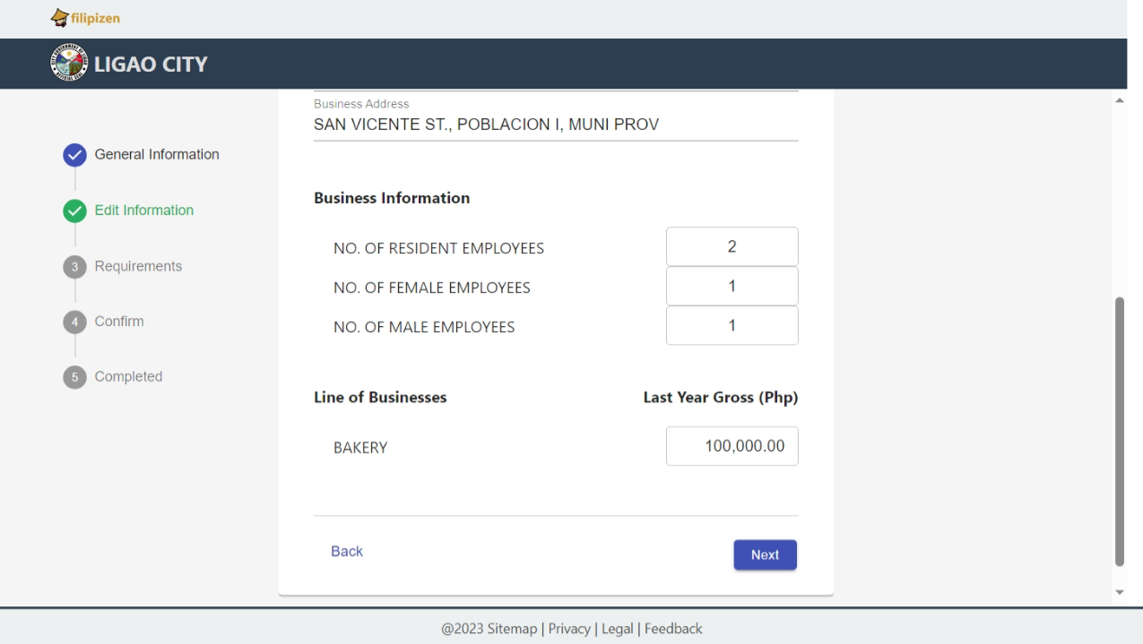
Online Business Renewal
Page 9

Slide 53
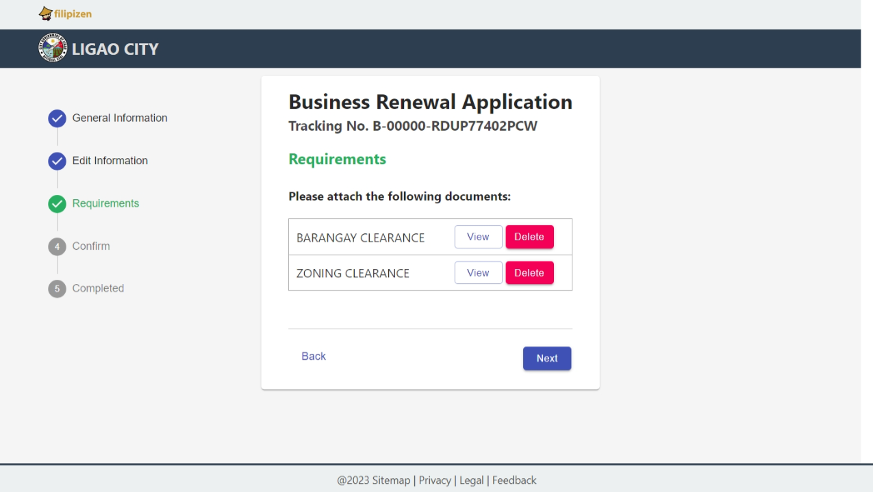
Online Business Renewal
Page 10

Slide 54
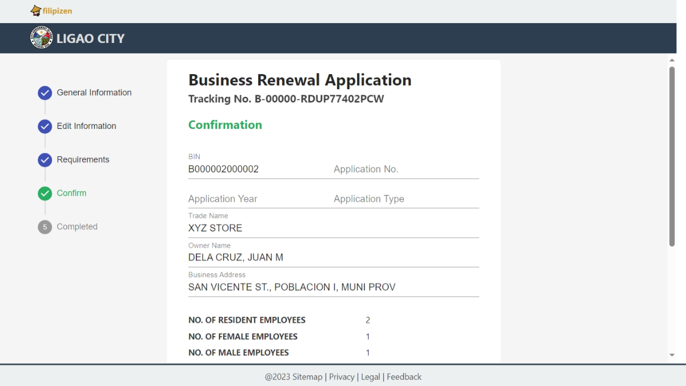
Online Business Renewal
Page 11

Slide 55
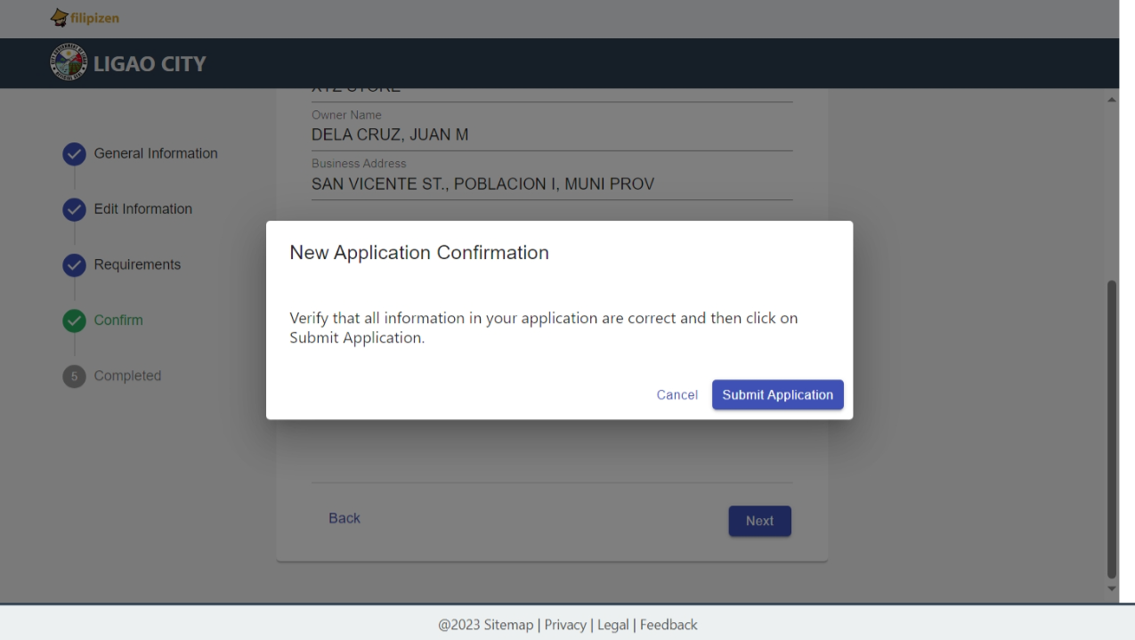
Online Business Renewal
Page 12

Slide 56
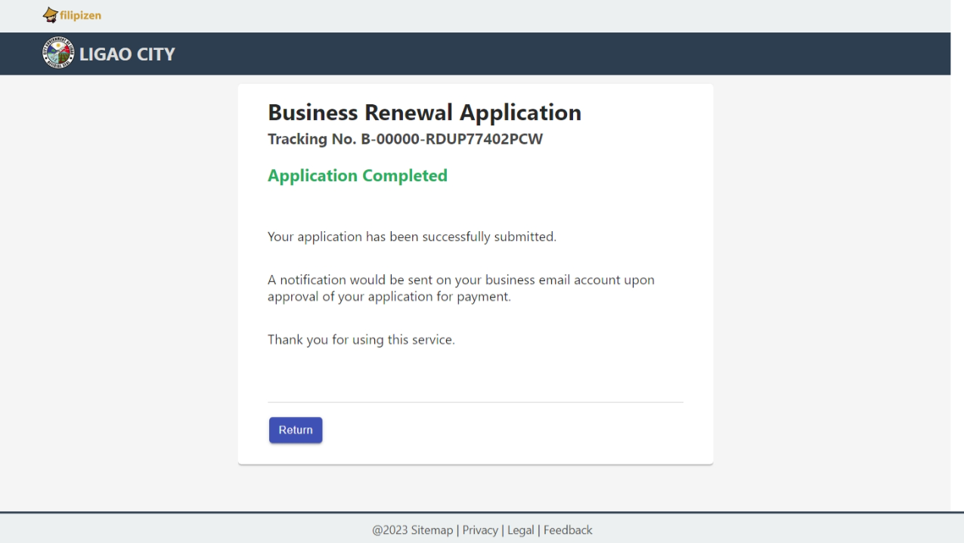
Online Business Renewal
Page 13

Slide 57
Process Online Business Renewal LGU Level

Slide 58
Process
The user will go to the menu Home-> Business-> Online-> View Online Applications
Select the Open menu item and open a particular record
Review the information and attachments
Once completed, click the Approve for Processing button and this will create an official business application record, and will go through the internal workflow process in processing a business application
An email will be sent to the applicant notifying the current status of the application
An email will be sent again as soon as the application is approved for payment
After payment made, releasing and issuance permit is performed

Slide 59
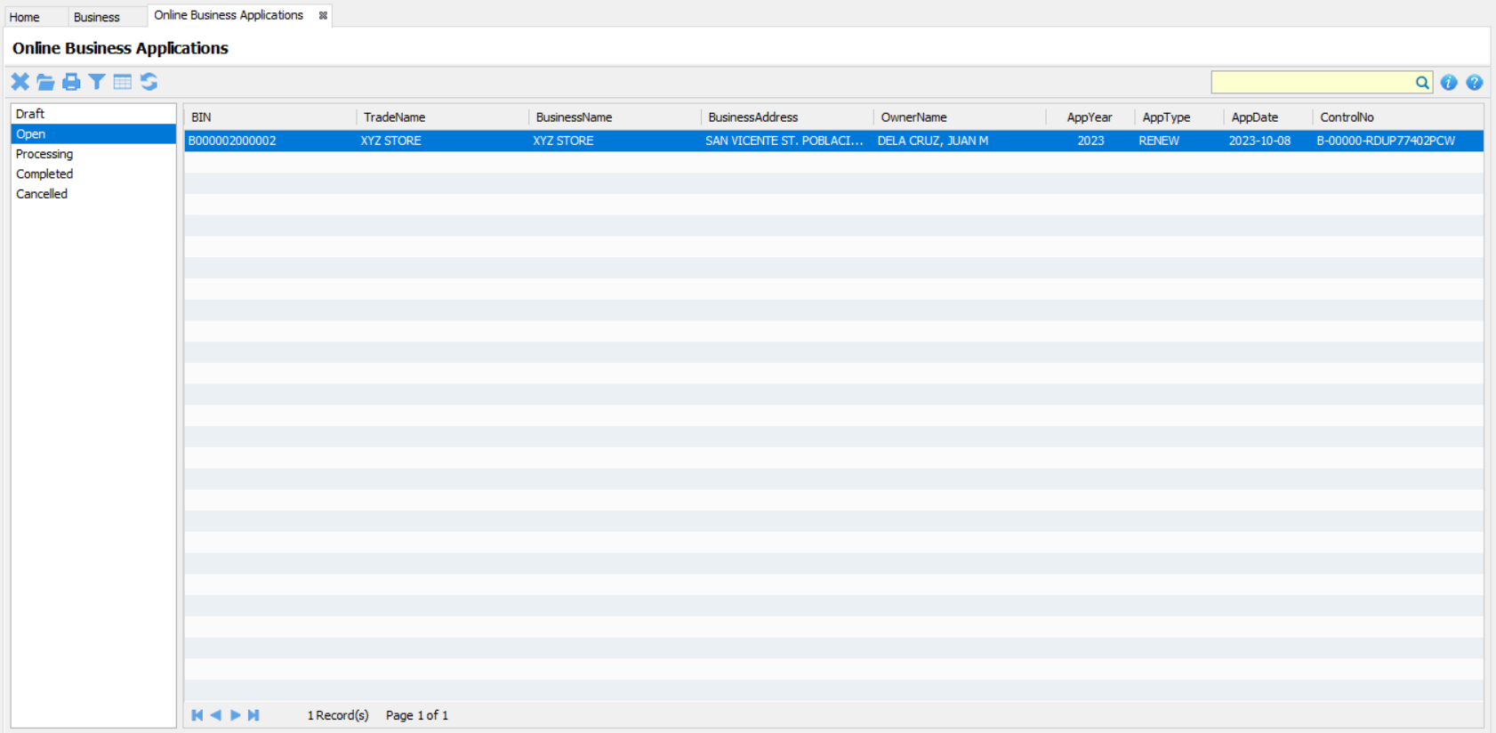
Processing Online Business Renewal
Page 1

Slide 60
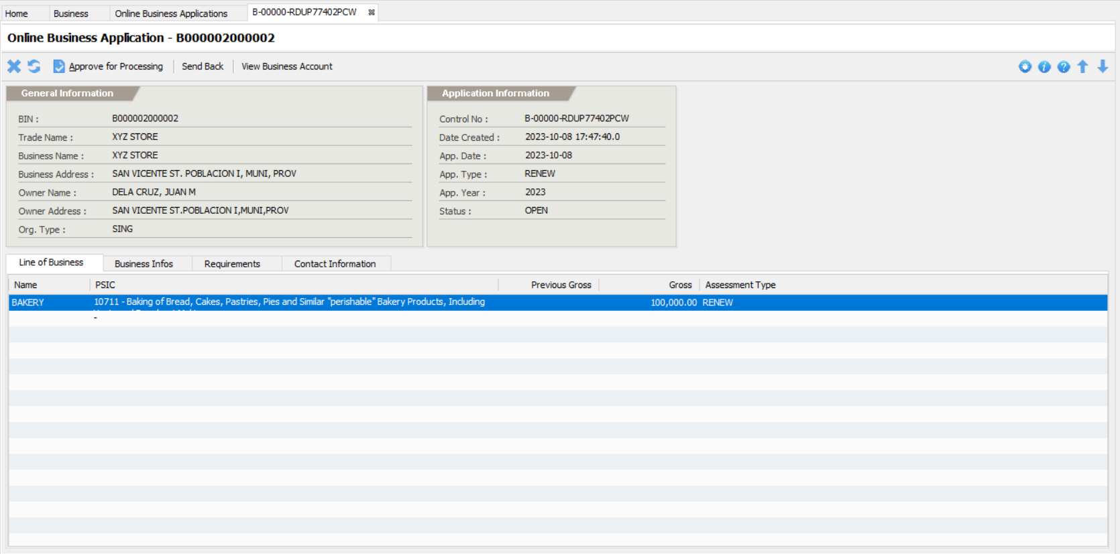
Processing Online Business Renewal
Page 2

Slide 61
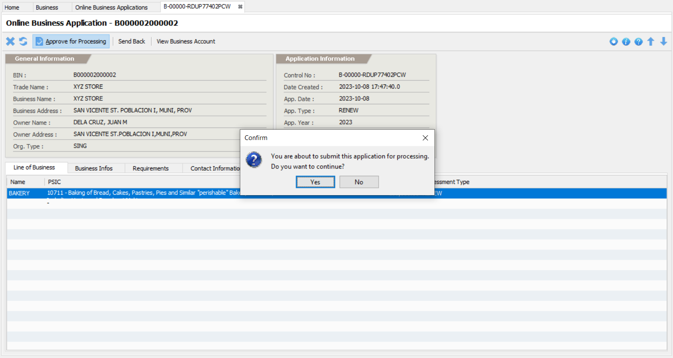
Processing Online Business Renewal
Page 3

Slide 62
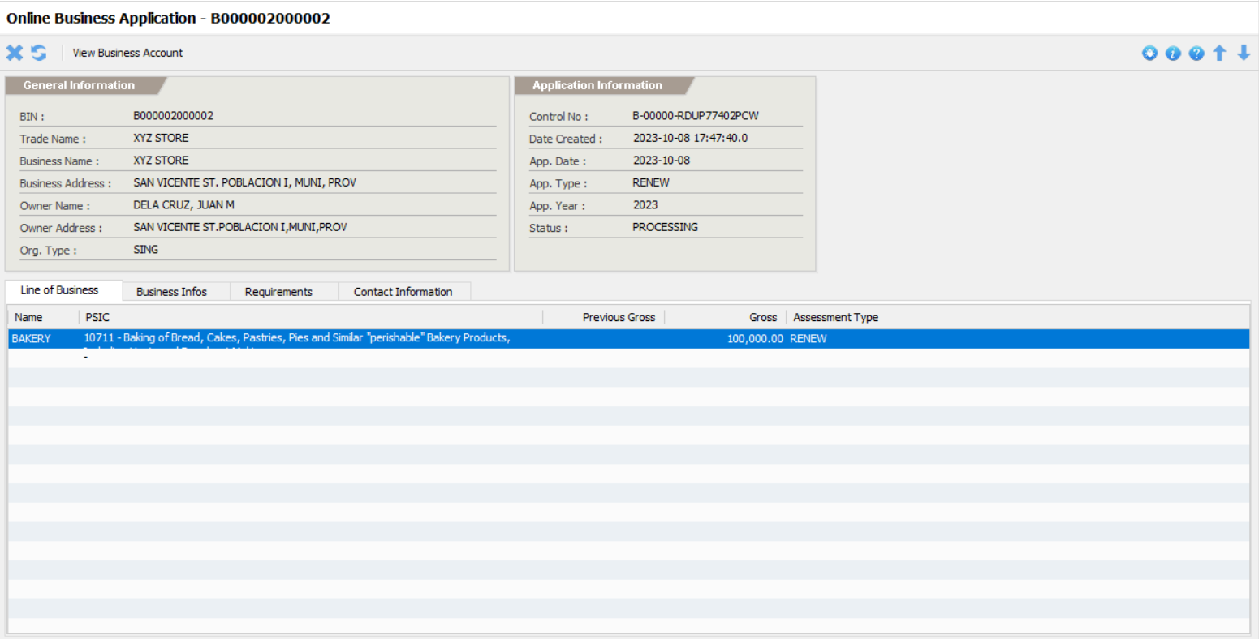
Processing Online Business Renewal
Page 4

Slide 63
MHO Assess The Application
Open the application from the notification menu or go to Home-> Business-> Management-> View Applications and click the MHO folder
Click the Assign To Me button
Click the MHO Fees menu item
Click the Add Fee button
After completely added the fees, click the Submit button

Slide 64
MPDO Assess The Application
Open the application from the notification menu or go to Home-> Business-> Management-> View Applications and click the MPDO folder
Click the Assign To Me button
Click the MPDO Fees menu item
Click the Add Fee button
After completely added the fees, click the Submit button

Slide 65
Assessor Assess The Application
Open the application from the notification menu or go to Home-> Business-> Management-> View Applications and click the Assign Assessor folder
Click the Assign To Me button
Click the Assessment menu item
Click the Assess button and provide the necessary information to output the correct computation of fees
After completely assessed, click the Submit for Approval button

Slide 66
Approver Approves The Application
Open the application from the notification menu or go to Home-> Business-> Management-> View Applications and click the Approval folder
Click the Assign To Me button
Click the Assessment menu item to review the fees
Click the Approve For Payment button to marked the application as ‘for-payment’ and then an email sent to the applicant notifying that the application is ready for payment

Slide 67
BFP Process the Application
Open the application from the notification menu or go to Home-> Business-> Management-> View Applications and click the BFP folder
Click the Assign To Me button
Compute the fees for payment
Once completed, click the Submit button

Slide 68
Process the Payment
The payment can now be done online or over-the-counter.
As soon as the payment has been made, the application will move to the next step.

Slide 69
Licensing Process the Application
Open the application from the notification menu or go to Home-> Business-> Management-> View Applications and click the For Release folder
Review the requirements
After the review, click the Release button
Click the Issue Permit button
Print the permit or send the permit as PDF via email

